Slide 1

Natural Language Processing
Amazon Fine Food Reviews
Team: We R Ready
Jiehao Pan/Santosh Mysore Vasudevan/ Siqi Wan/Yan Tan/Yanjun Yang

Slide 2

AGENDA
Introduction
Dataset Description
Text Preparation
Sentiment Analysis
Topic Modeling
Recommendation System

Slide 3

INTRODUCTION
Natural Language Processing:
Make machines to correctly read the language human speak.
To allow interactions
Text Mining:
Structuring the input text
Deriving patterns within the structured data
Evaluation and interpretation of the output

Slide 4
DATASET DESCRIPTION
568,454 observations
9 variables
Type | Variable Name
Int | Id, HelpfulnessNumerator, HelpfulnessDenominator, Score, Time
Factor | ProductId, UserId, Summary, Text

Slide 5
PACKAGES USED
Sentiment Analysis:
Processes text sentences and create a corpus. Functions: Corpus(), tm_map(), DocumentTermMatrix()
Other packages in SA: party, caret, e1071, kernlab
tm
topicmodels
Topic Modeling:
Provides an interface to the C code for Latent Dirichlet Allocation (LDA) models. Functions: LDA()
Recommendation System:
Provides a research infrastructure to test and develop recommender algorithms including UBCF, IBCF, FunkSVD and association rule-based algorithms.
recommenderlab

Slide 6

TEXT PREPARATION
Extract 20% observations as a sample
Remove the observations with neutral sentiment (Score = 3)
Split the dataset into train (60%) and test (40%)
Add a new column showed “positive” or “negative”
Convert corpus to a plain text document
Word stemming
Data processing transformation
Convert to corpus
Create DTM (Document Term Matrix)
mystopwords = c (stopwords('smart'), "amazon", "find", "found","make","makes","made","making","buy","buying","bought")

Slide 7

SENTIMENT ANALYSIS
Combine the sentiment with the term frequencies for train and test:
train_m = data.frame(y=train$Sentiment, x=as.matrix(train_dtm))
test_m = data.frame(y=test$Sentiment, x=as.matrix(test_dtm))
Supervised learning for sentiment classification:
Ctree classifier
Naive Bayes Classifier (algorithm used to predict binary classification model)
Ksvm classifier (Kernel Support Vector Machines)
Predict test dataset
Evaluate model by Confusion Matrix

Slide 8
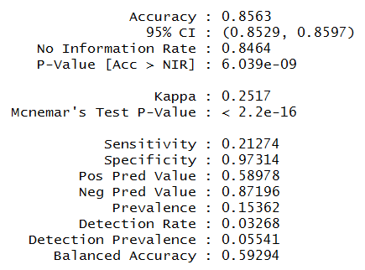
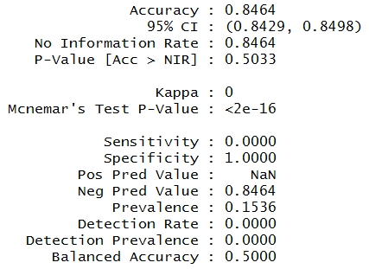
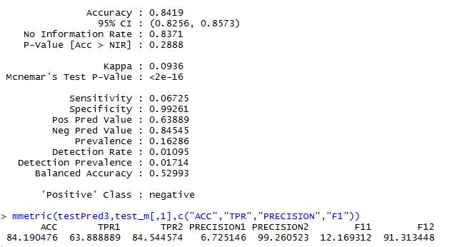
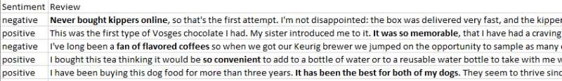
SENTIMENT ANALYSIS
Confusion Matrix Results:
CTree Classifier Naive Bayes Classifier Ksvm classifier
Prediction Results Screenshot:

Slide 9
TOPIC MODELING
Package: topicmodels
Function: LDA() [Latent Dirichlet Allocation Algorithm]
Extract 5% observations as a sample
Text Preparation (Create DTM)
Optimize number of topics
Final Model
How?
extract the log likelihood values for each model

Slide 10
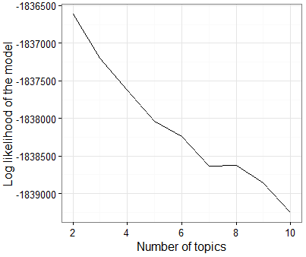
TOPIC MODELING
Log Likelihood vs Number of Topics
All Amazon food reviews
Topic don’t differentiate significantly
Choose 2-4 topics can get better model performance

Slide 11

TOPIC MODELING
Topics Picked

Slide 12
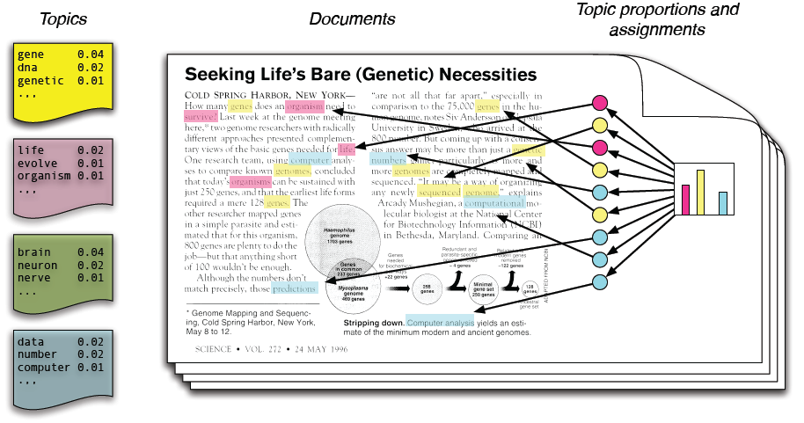

TOPIC MODELING
Insights and Usage

Slide 13







RECOMMENDATION SYSTEM
Customer X
Buys Metallica CD
Buys Megadeth CD
Customer Y
Does search on Metallica
Recommender system suggests Megadeth from data collected about customer X

Slide 14
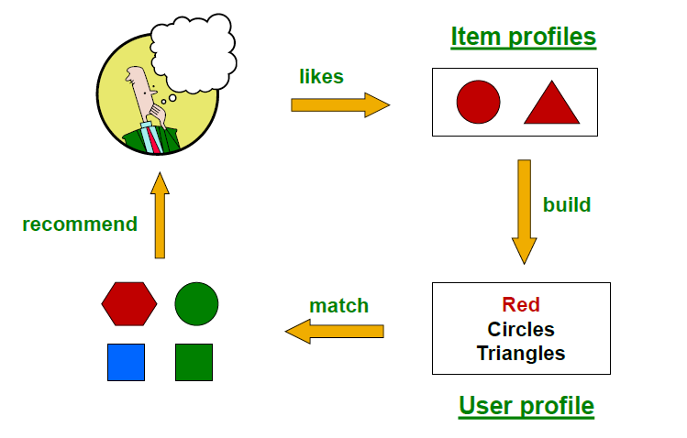
RECOMMENDATION SYSTEM
Content based recommendation system:
Main Idea: For each item an item profile is created. Based on the user’s search items having similar characteristics are recommended.
Pros:
No cold-start or sparsity problems.
No first-rater problem
Can provide explanations of recommended items by listing content-features that caused an item to be recommended
Cons:
Finding the appropriate features is hard
Recommendations for new users
Overspecialization

Slide 15
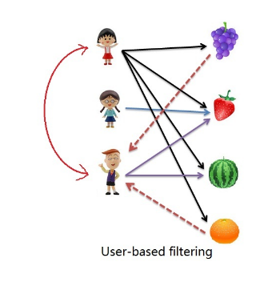

RECOMMENDATION SYSTEM
Collaborative Filtering- User Based
Main Idea:
Consider user X.
Find set N of other users whose ratings are “similar” to x’s ratings
Estimate x’s ratings based on ratings of users in N
Cosine similarity:

Slide 16
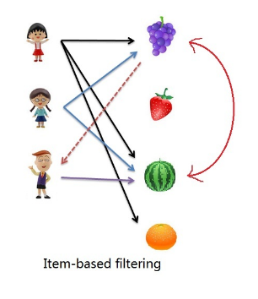
RECOMMENDATION SYSTEM
Collaborative Filtering- Item Based
Main Idea:
For item i, find other similar items.
Estimate rating for item i based on ratings for similar items
Can use same similarity metrics and prediction functions as in user-user model

Slide 17
RECOMMENDATION SYSTEM
Collaborative Filtering- Pros and Cons
Pros:
No feature selection needed
Cons:
Cold Start-Need enough users in the system to find a match
Sparsity- The user/ratings matrix is sparse i.e, Hard to find users that have rated the same items
First rater-Cannot recommend an item that has not been previously rated
Popularity bias-Cannot recommend items to someone with unique taste;tends to recommend popular items

Slide 18
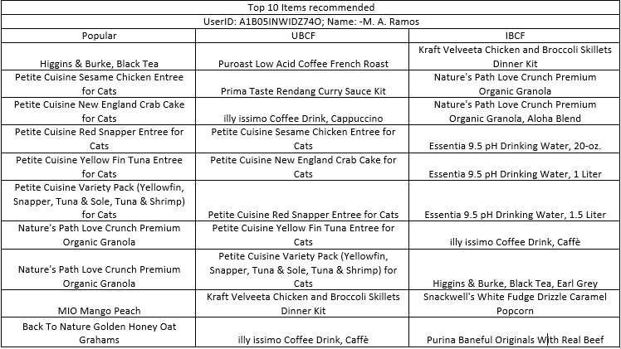
RECOMMENDATION SYSTEM
Collaborative Filtering- Results

Slide 19
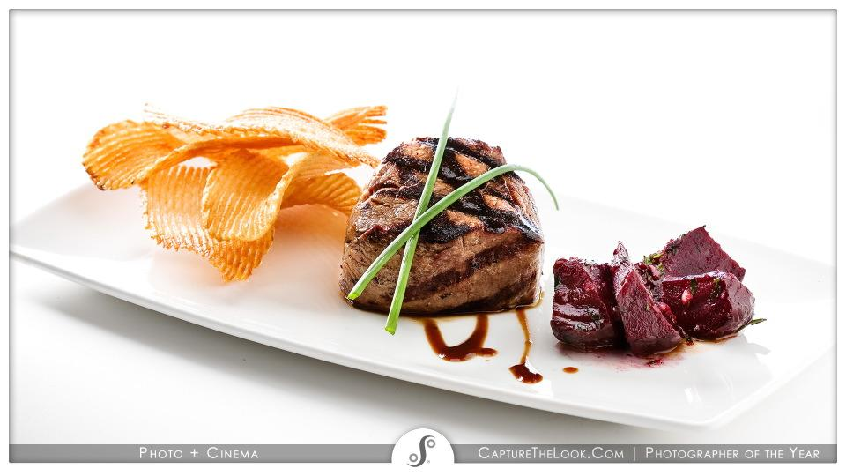
THANK YOU!

